Slide 1


Ministry of Communications and Information Technology
Information Technology Institute
Information Technology Institute
Network Fundamentals
Introduction to Internet
Lec2

Slide 2
OSI Reference Model
OSI: Open Systems Interconnection
The OSI model is the primary architectural model for networks.
It describes how data and network information are communicated from an application on one computer, through the network media, to an application on another computer.
The model was defined by the International Organization for Standardization (ISO)
The OSI reference model breaks this approach into layers.

Slide 3
Advantages of Reference Models
It divides the network communication process into smaller and simpler components, thus aiding component development, design, and troubleshooting.
It allows multiple-vendor development through standardization of network components.
It encourages industry standardization by defining what functions occur at each layer of the model.
It allows various types of network hardware and software to communicate.
It prevents changes in one layer from affecting other layers, so it does not hamper development.

Slide 4
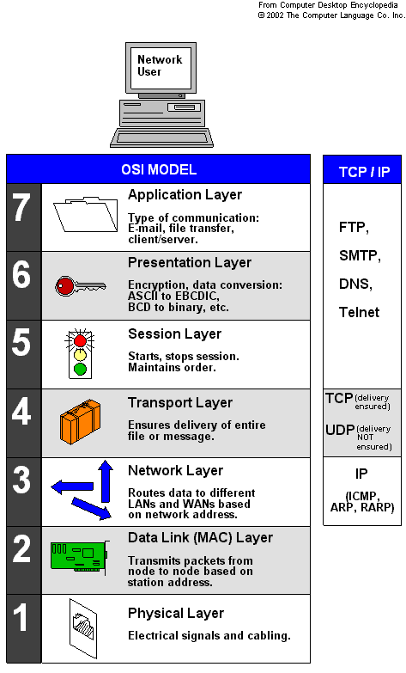
OSI Seven Layers
Application
Presentation
Session
Transport
Network
Data Link
Physical

Slide 5

Application Layer
What should I send?
End-user Interface
Where client applications reside
Displays received information
Sends user’s data to lower layers
Notes:
Application Layer
provides a means for the user to access information on the network through an application.
This layer is the main interface for the user(s) to interact with the application and therefore the network.

Slide 6
Presentation Layer
The presentation layer is responsible for the delivery and formatting of information to the application layer for further processing or display.
It relieves the application layer of concern regarding syntactical differences in data representation within the end-user systems.
An example of a presentation service would be the conversion of an EBCDIC-coded text file to an ASCII-coded file.
Notes:
EBCDIC: Extended Binary Coded Decimal Interchange Code
ASCII: American Standard Code for Information Interchange

Slide 7


Session Layer
Controls the sessions between the local and remote applications
I would like to
send you
something.
Sounds
good!
Thank you.
You are
welcome!
Establish
Connection
Close
Connection
Notes:
The Session layer controls the sessions between computers.
It establishes, manages and terminates the connections between the local and remote application.

Slide 8
Transport Layer
There is services that can be optionally provided at this layer:
  Connection-Oriented
  Reliable Data
Notes:
Organize data into segments
Provide transparent transfer of data between hosts.
It is usually responsible for end-to-end error recovery and flow control, and ensuring complete data transfer.

Slide 9
Network Layer
Organize data into datagrams (packets)
Addresses messages
Routing
  Provides the functional and procedural means of transferring variable length data sequences from a source to a destination via one or more networks

Slide 10
Data Link Layer
Reliable data transfer across a physical link
  It provides the means to detect errors that may occur in the Physical layer.
Organize the data into frames, to be put on the physical medium

Slide 11
Physical Layer
The Physical layer defines all the electrical and physical specifications for devices.
The physical layer is the most basic network layer, providing only the means of transmitting raw bits.
Notes:
Transmission of unstructured bit stream over the physical link

Slide 12
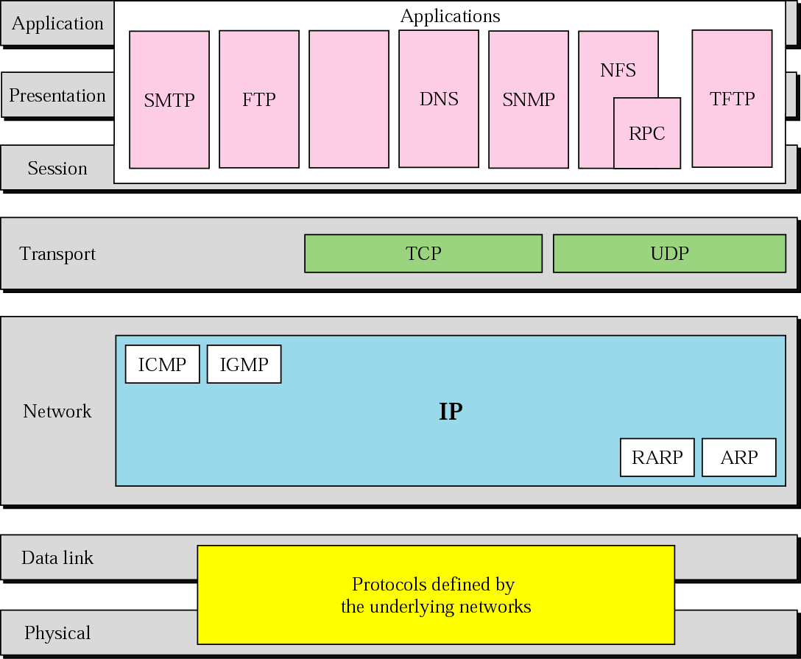
TCP/IP Protocol Suite

Slide 13
Addressing

Slide 14
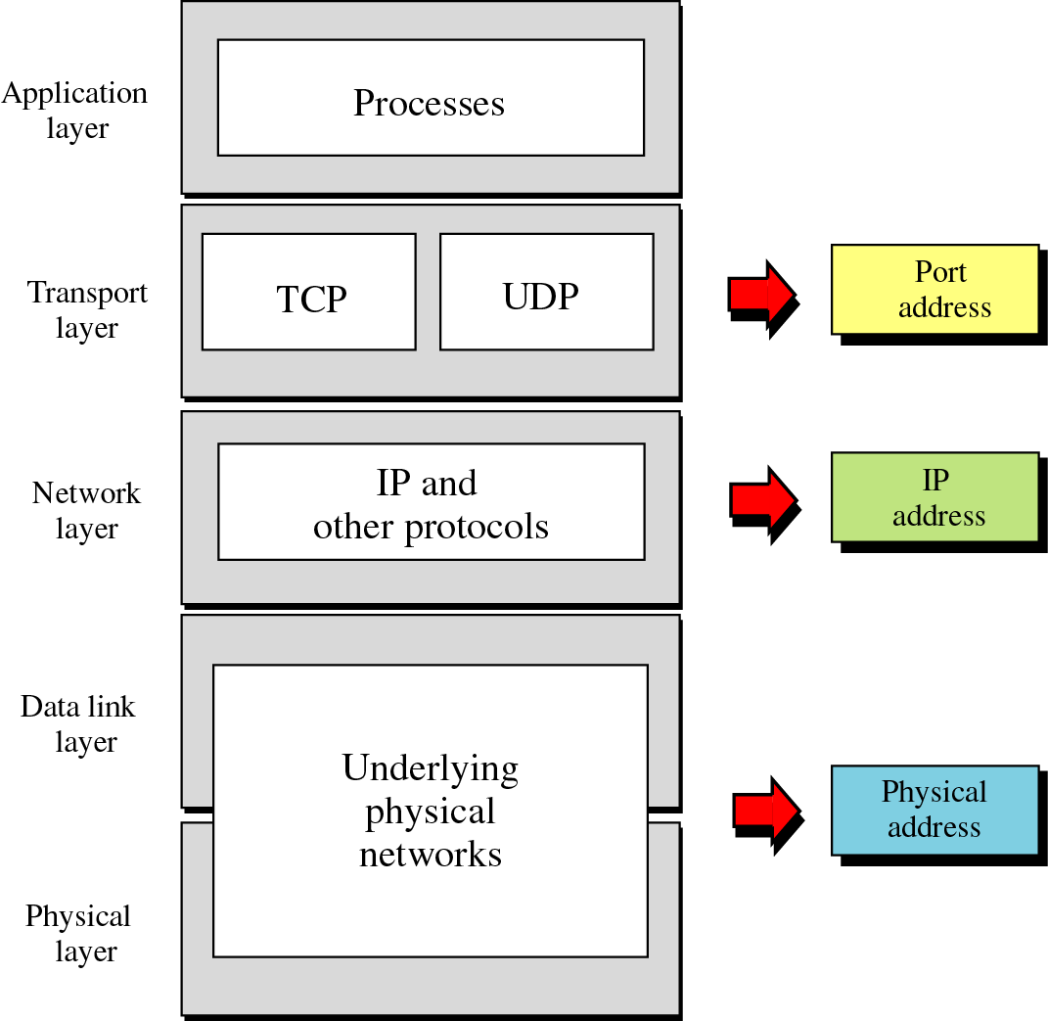
Layers and Addresses in TCP/IP

Slide 15
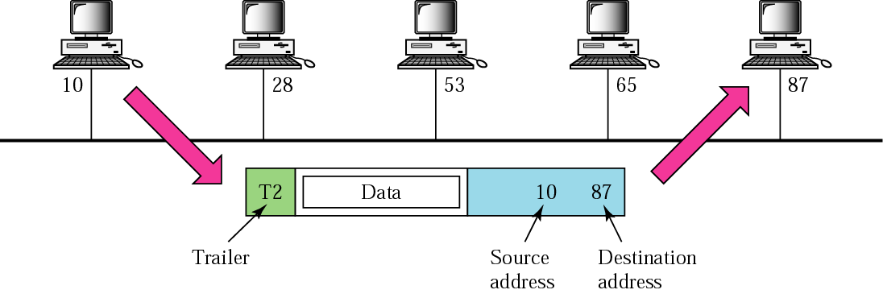
Physical addresses

Slide 16
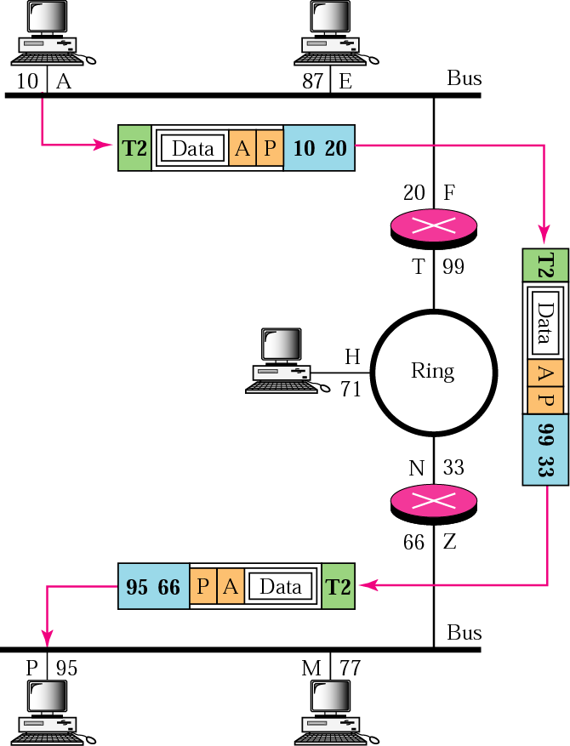
IP addresses

Slide 17
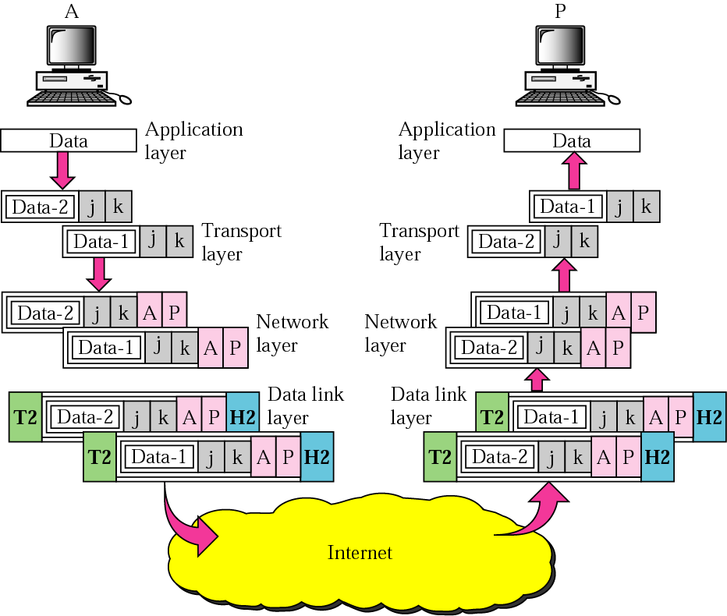
Port addresses

Slide 18

Network Layer Addressing
Provides physical routing information
Where do I go?
Notes:
Network Layer
This layer is responsible for routing and data flow to the right places. It can also accept packets make sure they no larger than the accepted bandwidth and send them on there way. Routers and gateways operate in this layer.

Slide 19
IP Address
32 Bits
Dotted
Decimal
Network
Host
255
255
255
255
Maximum
Notes:
Layer 1 of 3
Purpose: This figure show the general format of an IP address.
Emphasize: In layer 1, the address is 32 bits with a network and host portion.

Slide 20
IP Addressing
32 Bits
Dotted
Decimal
Network
Host
255
255
255
255
Maximum
1
8
9
16
17
24
25
32
11111111
11111111
11111111
11111111
Binary
128
64
32
16
8
4
2
1
128
64
32
16
8
4
2
1
128
64
32
16
8
4
2
1
128
64
32
16
8
4
2
1
Notes:
Layer 3 of 3
Emphasize: In layer 2, one can convert the address to binary.

Slide 21
Decimal Equivalents of Bit Patterns
128 64 32 16 8 4 2 1
0 0 0 0 0 0 0 0 = 0
1 0 0 0 0 0 0 0 = 128
1 1 0 0 0 0 0 0 = 192
1 1 1 0 0 0 0 0 = 224
1 1 1 1 0 0 0 0 = 240
1 1 1 1 1 0 0 0 = 248
1 1 1 1 1 1 0 0 = 252
1 1 1 1 1 1 1 0 = 254
1 1 1 1 1 1 1 1 = 255
Notes:
Purpose: This figure explains how subnet masks are converted to decimal addresses.
Emphasize: Review binary-to-decimal conversion, bit weighting, and conversion.
Explain the logical AND.
One possible explanation of the logical AND follows. We will need to be able to perform a logical AND on the binary numbers. Just take two binary numbers and place one above the other. The ones in the bottom are like a pipe—the number above it just drops through. The zeros are like a clogged pipe, so nothing comes out in the answer.
Presenting a truth table will help some students understand. You might need to give more than one explanation.
Note: You might want to hand out a binary-to-decimal conversion sheet if you have not already done so. We have not included one in the lab section. It is more useful to have one that is on a separate page from the labs.

Slide 22
IP Address Classes
8 Bits
8 Bits
8 Bits
8 Bits
Network
Host
Host
Host
Class A:
Class B:
Class C:
Class D: Multicast
Network
Network
Host
Host
Network
Network
Network
Host
Notes:
Slide 1 of 2
Purpose: This graphic describes the three most common classes of IP address.
Emphasize: Discuss classes of addresses. Each address contains information about the network number and the host number of the device. Class A addresses are for very large organizations, Class B addresses are for smaller organizations, and Class C addresses for even smaller ones.
As the number of networks grows, classes may eventually be replaced by another addressing mechanism, such as classless interdomain routing (CIDR). RFC 1467, Status of CIDR Deployment in the Internet, presents information about CIDR. RFC 1817, CIDR and Classful Routing, also presents CIDR information.

Slide 23
IP Address Classes
1
8
9
16
17
24
25
32
Bits:
0NNNNNNN
Host
Host
Host
Class A:
Range (1-126)
1
8
9
16
17
24
25
32
Bits:
10NNNNNN
Network
Host
Host
Class B:
Range (128-191)
1
8
9
16
17
24
25
32
Bits:
110NNNNN
Network
Network
Network
Network
Network
Network
Network
Network
Network
Host
Class C:
Range (192-223)
1
8
9
16
17
24
25
32
Bits:
Multicast Group
Multicast Group
Multicast Group
Multicast Group
Multicast Group
Multicast Group
Multicast Group
1110MMMM
Multicast Group
Class D:
Range (224-239)
Notes:
Slide 2 of 2
Emphasize: Highlight the fixed values that start each class address.
The first octet rule states that when an address falls into a specified range, it belongs to a certain class. Students should soon be able to recognize the address class of any IP address on sight.
Note: If time or interest permits, you can use the initial bit patterns in the first octet and show how a class of IP network derives the range of network numbers for that IP address class.

Slide 24
Special IP Address
Private IP
  The Internet Assigned Numbers Authority (IANA) has reserved the following three blocks of the IP address space for private internets (local networks):
    10.0.0.0 - 10.255.255.255 >> Class A
    172.16.0.0 - 172.31.255.255 >> Class B
    192.168.0.0 - 192.168.255.255 >> Class C
Loopback Address
    127.0.0.1
Notes:
10.0.0.0 through 10.255.255.255
169.254.0.0 through 169.254.255.255 (APIPA only)
172.16.0.0 through 172.31.255.255
192.168.0.0 through 192.168.255.255

Slide 25
How to assign IP address to device
Manually
Automatic
APIPA

Slide 26
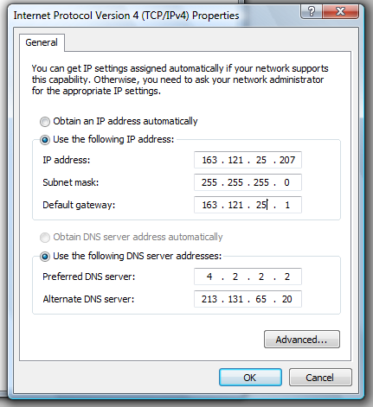
Assign IP address manually
Set IP address
Set Subnet mask
Set IP default-Gateway
Set DNS server
Notes:
1) Go to Start and click on Control Panel.
2) Control Panel window will appear. Double click on Network Connections.
3) Network Connections window will appear. Right click correct Local Area Connection by identifying correct network card and click Properties.
4) Select Internet Protocol (TCP/IP). Click on Properties.

Slide 27
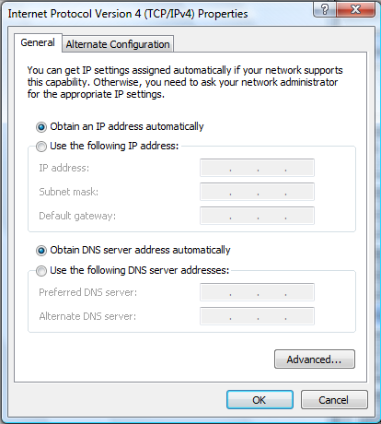
Assign IP address Automatic
The Device get the IP address through the DHCP Server.

Slide 28
ipconfig
ipconfig is a command line utility in Microsoft Windows.
ipconfig allows you to get the IP address information of a Windows computer
  MAC Address
  IP address
  Default gateway
  Subnet mask
  DNS server
Notes:
C:\Users\nour>ipconfig
Windows IP Configuration
Ethernet adapter Local Area Connection:
Connection-specific DNS Suffix . :
Link-local IPv6 Address . . . . . : fe80::df8:969c:fdbf:cb4%9
IPv4 Address. . . . . . . . . . . : 163.121.12.207
Subnet Mask . . . . . . . . . . . : 255.255.255.0
Default Gateway . . . . . . . . . : 163.121.12.1
--------------------------------------------------------------------------------------------------
C:\Users\rania>ipconfig /all
Windows IP Configuration
Host Name . . . . . . . . . . . . : rania
Primary Dns Suffix . . . . . . . :
Node Type . . . . . . . . . . . . : Hybrid
IP Routing Enabled. . . . . . . . : No
WINS Proxy Enabled. . . . . . . . : No
Ethernet adapter Local Area Connection:
Connection-specific DNS Suffix . :
Description . . . . . . . . . . . : Broadcom NetXtreme 57xx Gigabit Controlle
r
Physical Address. . . . . . . . . : 00-13-72-A5-12-FE
DHCP Enabled. . . . . . . . . . . : No
Autoconfiguration Enabled . . . . : Yes
Link-local IPv6 Address . . . . . : fe80::df8:969c:fdbf:cb4%9(Preferred)
IPv4 Address. . . . . . . . . . . : 163.121.12.207(Preferred)
Subnet Mask . . . . . . . . . . . : 255.255.255.0
Default Gateway . . . . . . . . . : 163.121.12.1
DNS Servers . . . . . . . . . . . : 4.2.2.2
213.131.65.20
NetBIOS over Tcpip. . . . . . . . : Enabled

Slide 29
Internet Services
The World Wide Web: HTTP
File Transfer: FTP
Electronic Mail service: IMAP, POP3, SMTP
Naming Service: DNS
Telnet Service

Slide 30
Web Server and Clients

Slide 31
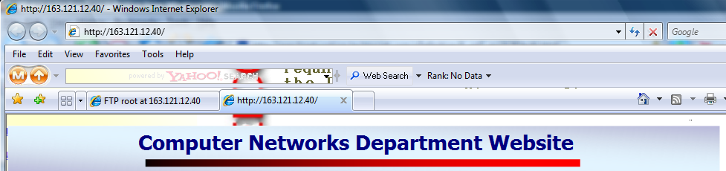
Browser as a web client
Use Internet Browser as WEB client.

Slide 32
FTP Server and Clients

Slide 33
FTP Client
Browser as a FTP client
Using MS Windows built-in FTP client
Third party programs “cute FTP”

Slide 34
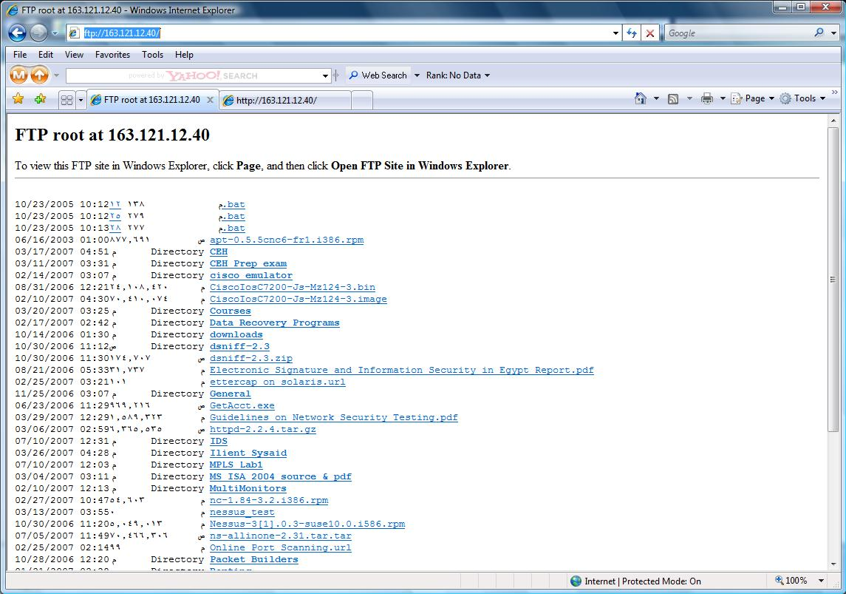
Browser as a FTP client
Use Internet Browser as FTP client.

Slide 35
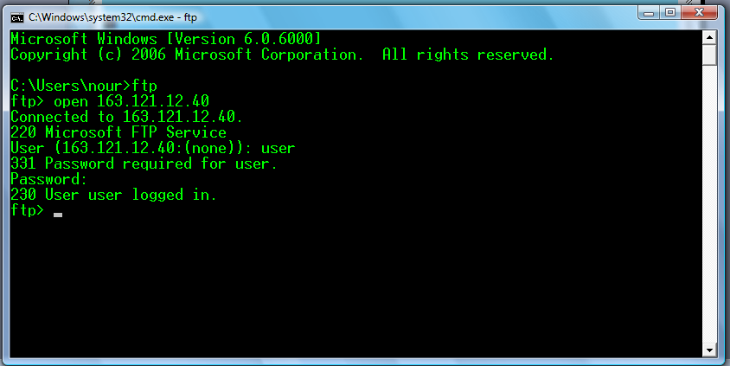
Using MS Windows built-in FTP client
Start >> run >> cmd
open
ls
cd
bin
get
mget
Put
bye
Try these commands

Slide 36
Mail Server and Clients

Slide 37
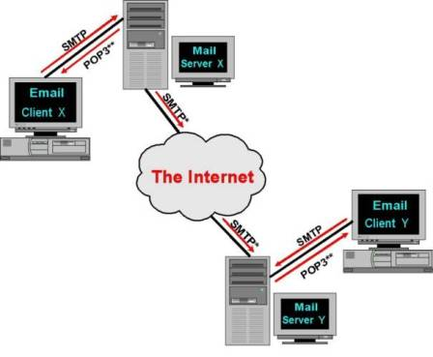
Mail Server

Slide 38
Mail Protocols
SMTP
  It is the common language used by the majority of Mail Servers to send messages back and forth to other Mail Servers or Email Clients
POP3 “Post Office Protocol version 3”
  In order to collect email messages from the Mail Server, the Email Client contacts the Mail Server.
  Download msgs on the H/D
  You can work Offline
  Keep the user’s quota on the server
IMAP4 “Internet Message Access Protocol version 4”
  Retrieve only msgs header

Slide 39
Mail Clients
Web based
Non web based
  Outlook express
  Microsoft Outlook

Slide 40
Telnet Services

Slide 41
Telnet
  Telnet is a user command and an underlying TCP/IP protocol for accessing remote computers.
  Through Telnet, an administrator can access someone else's computer remotely

Slide 42
Telnet client
Built in MS-Windows Telnet client
Third party programes

Slide 43
Naming Services

Slide 44

URL
URL is Universal Resource Locator
Protocol : HTTP or FTP

Slide 45
DNS
At the beginning they use Hosts file
It maps the IP addresses to host names
It is found at “C:\Windows\System32\drivers\etc”
Then they make DNS Server to centralize the Domain Name Servers.
Servers are used to convert the addresses we see and read into IP addresses and vice-versa.

Slide 46
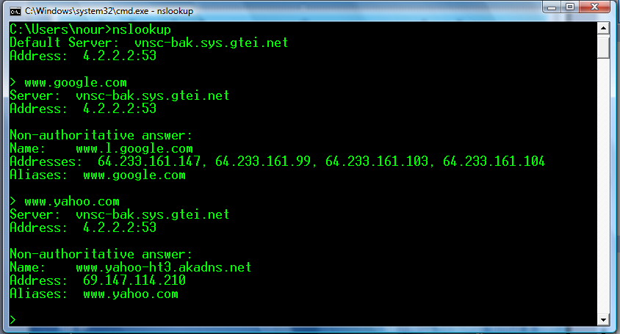
nslookup
nslookup is the name of a program that lets you to enter a host name and find out the corresponding IP address

Slide 47
Client/Server Examples
Client | Protocol | Server | Port No
Browser | HTTP | WEB | 80
Browser | FTP | FTP | 21
Browser Or Outlook Express Microsoft Outlook | HTTP SMTP POP3 IMAP4 | Mail | 110 143 25
Telnet | Telnet | Telnet | 23
Notes:
Note
POP3, IMAP4, Telnet, HTTP and SMTP operate using the TCP/IP Protocol
HTTP (HyperText Transfer Protocol)
HTTP is the standard language used for sending web pages.
FTP (File Transfer Protocol)
FTP used in the transmission of files.
Post Office Protocol (POP)
In order to collect email messages from the Mail Server, the Email Client contacts the Mail Server and supplies it with an account “user” name and a password. Only then will the Mail Server offer a count of pending messages stored for that account.
SMTP (Simple Mail Transfer Protocol)
Simple Mail Transfer Protocol (SMTP) a standard set of rules and procedures whereby messages could be transferred over the Internet. It is the common language used by the majority of Mail Servers to send messages back and forth to other Mail Servers or Email Clients.
The SMTP system uses Domain Name System (DNS) to convert the Domain Name component of a typical email address
DNS Server is (Domain Name Services)
The Internet works on IP addresses; DNS (Domain Name Services) Servers are used to convert the addresses we see and read into IP addresses and vice-versa.

Slide 48
Thank you

